Slide 1
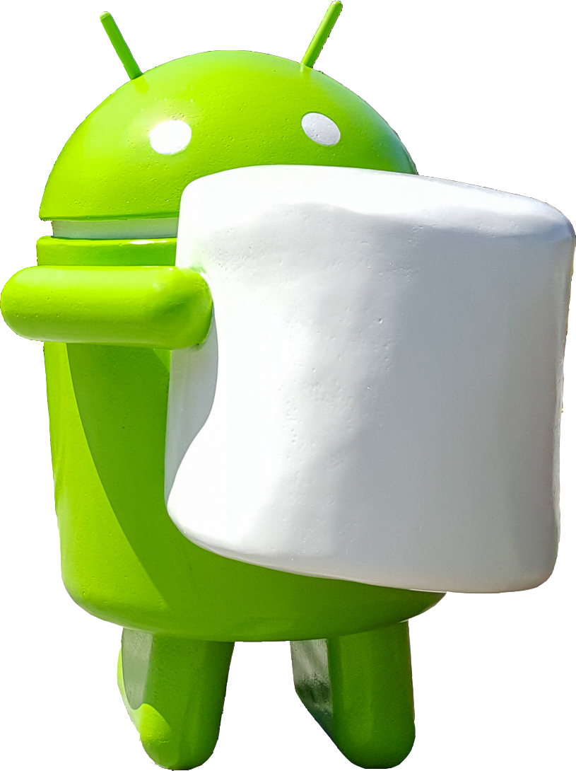

Slide 2
Objectives
At the end of this module, you will be able to :
Implement Data Binding
Understand Android Percent Layout in Android Marshmallow
Learn about Android M Runtime Permissions
Implement App Linking in Android M
Understand Direct Share feature in Android M

Slide 3
Data Binding
Data binding becomes part of the developer’s tool set in Android Marshmallow
The Data Binding library provides a mechanism for linking the data which will be displayed within our layouts to some kind of back-end data source
Data Binding Library is used to write declarative layouts and minimize the glue code necessary to bind your application logic and layouts
To set up your application to use data binding, add data binding to the class path of your top-level build.gradle file

Slide 4
Data Binding
dependencies {
classpath "com.android.tools.build:gradle:1.3.0"
classpath "com.android.databinding:dataBinder:1.0-rc1"
}
Jcenter should be present in your repository list of your projects in Top Level
new_project {
repositories {
jcenter()
}
}
In the build.gradle for the Android application sub-project we apply a build plugin
apply plugin: 'com.android.application'
apply plugin: 'com.android.databinding'

Slide 5
Data Binding
Once the data binding is added , create a POJO for the binding.
Update the layout file by adding some meta-data/markup
Update the activity to declare the data binding
Demo

Slide 6
Android Percent Layout
There are problems with RelativeLayout and FrameLayout since you cannot set Child View's dimension in percentage
There are times where a particular layout requires us to divide space between components proportionally, but the parent layout is not a LinearLayout
It is not a problem anymore as in Marshmallow, Android team launched many Support Library to help developer fighting with fragmentation. One of those is Percent Support Library which add an capability to set RelativeLayout's and FrameLayout's dimension in %
Problem
Solution

Slide 7
Android Percent Layout
First we need to include the percent support library in build.gradle file
compile 'com.android.support:percent:23.0.0‘
Now you can switch to android.support.percent.PercentRelativeLayout and android.support.percent.PercentFrameLayout
Demo

Slide 8
Runtime Permission
Android 6.0 Marshmallow introduces one of the largest changes to the permissions model with the addition of runtime permissions
It replaces the existing install time permissions model when you target API 23 and the app is running on an Android 6.0+ device
Features :
Ability to control when and with what context you’ll ask for permissions
Google Play will not be required to accept a list of permissions before installing your app
App updates will not be blocked until the user accepts the new permissions

Slide 9
App Linking
In Android M, when a user clicks on a website link , instead of asking the user to choose how to handle the link he/she directly goes to the website's official app
For example, if a twitter link is there in your inbox and you clicked on it, you used to get a prompt asking if you want to open the link in your browser or within the Twitter app, which is installed on your phone, now you will be directly re-directed to the twitter app, provided twitter app is there on your device.

Slide 10
App Linking
To enable your app to handle links, use intent filters in your app manifest to declare the URI patterns to be handled by your app
To enable link handling verification for your app, set the android:autoVerify attribute to true on at least one of the web URI intent filters in your app manifest

Slide 11
Test App Linking
Test you App linking feature by confirming the list of associated hosts that the system should verify for your app
Confirm that the Digital Asset Links JSON file is properly hosted and defined by using the Digital Asset Links API
Testing a web URI intent
Check the current system settings for link handling

Slide 12
Direct Share
Direct Share is a new feature in Marshmallow that provides APIs for allowing users to share content to other sources such as contacts and social networks
Google calls it as a dummy messaging app
Also allows users to share to specific targets, and demonstrates this by adding contacts directly in the chooser dialog
Example - if you frequently send your significant pictures via Hangouts, Android M will recognize this habit and offer a single button to let you share directly with them

Slide 13
Direct Share
To enable Direct Share, apps need to implement a Service extending ChooserTargetService. Override the method onGetChooserTargets() and return a list of Direct Share options
In your AndroidManifest.xml, add a meta-data tag in your Activity that receives the Intent. Specify android:name as android.service.chooser.chooser_target_service, and point the android:value to the Service
Demo

